Slide 1
Early Detection of Breast Cancer Through Ultrasound Images using Meta Learning
Md. Najmus Sakib
ID : 221-15-5127
Department of CSE
Daffodil International University
Dr. Md. Zahid Hasan
Associate Professor
Department Of CSE
Daffodil International University

Slide 2
Outline
Introduction
Problem Statement
Motivation and Objective
Related Works
Comparison Between Existing Works
Gap Analysis
Proposed Methodology
Q & A

Slide 3
Introduction
Breast cancer is a leading cause of cancer-related deaths in women worldwide.
Early and accurate detection improves survival rates and reduces treatment complexity.
Ultrasound imaging is widely used due to safety, accessibility, and suitability for dense breast tissue.
Meta-learning enables robust classification with small datasets, ideal for medical imaging constraints.
This research integrates Prototypical Networks with Segmentation-Guided Attention (SGA) for accurate and explainable breast ultrasound classification using the BUS-BRA dataset.

Slide 4
Problem Statement
Ultrasound images of the breast are difficult and time consuming to interpret manually and are susceptible to errors.
Traditional deep learning models require large, balanced datasets, which are scarce in medical imaging.
There is a lack of explainable AI systems tailored for breast ultrasound classification.
Existing methods struggle with class imbalance and generalization across varying image quality.

Slide 5
Motivation and Objective
Motivation:
Improve early breast cancer detection through AI-assisted ultrasound diagnosis.
Reduce diagnostic variability among radiologists.
Leverage meta-learning for data-efficient model training.
Objectives:
Build a few-shot learning classification framework for breast ultrasound images.
Integrate SGA to enhance interpretability and focus on lesion areas.
Use BUS-BRA dataset with BI-RADS annotation for training and evaluation.
Achieve >90% accuracy with limited training data.

Slide 6
Related Works
Gómez‐Flores, (2024): BUS‐BRA: a breast ultrasound dataset for assessing computer‐aided diagnosis systems.
Ali, A. (2023): Breast cancer classification through meta-learning ensemble technique using convolution neural networks.
Dan, (2024): Diagnostic performance of deep learning in ultrasound diagnosis of breast cancer
Işık, (2024): Few-shot classification of ultrasound breast cancer images using meta-learning algorithms.
Padmini P, (2024): Breast Cancer Classification through Meta-Learning Ensemble Model based on Deep Neural Networks.

Slide 7
Comparison Between Existing Works
Author(s) & Year | Method Used | Reported Metric | Relevance to My Work
Al-Taie et al. (2024) | Few-Shot Meta-Learning (DenseNet-121) | 96.9% Accuracy | Directly applies meta-learning for BUS classification with limited data, similar to my final goal.
Shen et al., 2025 | Multi-Task Learning (Segmentation + Classification) with Attention | 97.1% Accuracy | Uses an attention module and performs segmentation jointly with classification.
Wang et al., 2024 | Single-Task Meta-Learning + Auxiliary Network | +1.85% Accuracy Boost | Proposes a novel meta-learning strategy to improve generalization on diverse breast tumor images.
Sarki et al., 2023) | CNN with a CBAM Attention Module | 98.8% Accuracy | Demonstrates the power of a standard attention mechanism to improve feature extraction in BUS images.
Liu et al., 2023 | Meta-Learning + Ordinal Classification | 89.5% Accuracy | Employs ordinal classification within a meta-learning framework to respect the severity ranking in medical images.

Slide 8
Gap Analysis
Lack of integrated attention in meta-learning approaches for breast ultrasound.
Explainability missing in most few-shot classification systems.
Few studies focus on public datasets like BUS-BRA for reproducibility.
Limited research on BI-RADS based automated classification using few-shot learning.

Slide 9
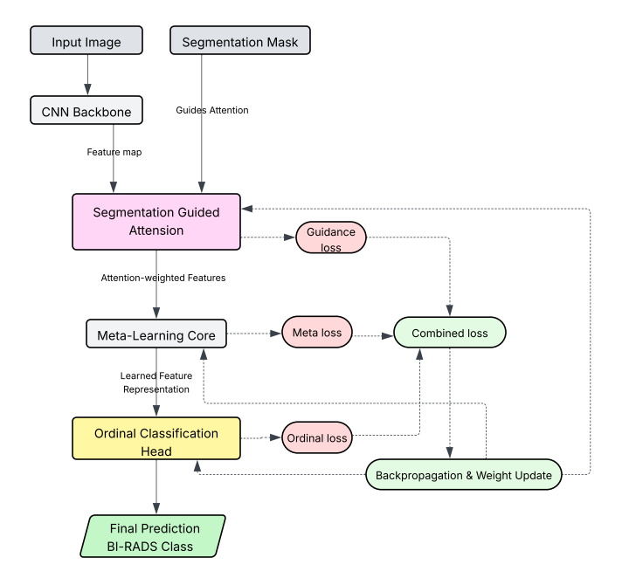
Proposed Methodology
The proposed methodology integrates a CNN backbone with a Segmentation-Guided Attention (SGA) module to focus on lesion regions, followed by a meta-learning core and ordinal classification head to predict BI-RADS categories, optimized using combined guidance, meta, and ordinal losses.

Slide 10


Slide 11
THANK YOU

